Slide 1
Evaluation of Biochemical Parameters and Imaging Methods in Management of Patients with Renal Colic
Zeynep Akdemir¹, Cevper Ersöz²
¹ Bezmialem Vakif University School of Medicine, İstanbul, Turkey
² Department of Urology, Bezmialem Vakif University School of Medicine, İstanbul, Turkey

Slide 2
Introduction
Acute renal colic which is one of the common causes of emergency admissions is the sudden onset of blunt and agonizing pain localized in the costovertebral angle, lateral of the sacrospinous muscle and below the 12th rib due to urinary system obstruction and/or inflammation.
In the diagnosis of renal colic, imaging methods (USG, radiography of the urinary tract, CT) are used after taking anamnesis and physical examination.
Changes in biochemical parameters (urea, creatinine) of patients are often expected.
Repetitive CT scans have some disadvantages in terms of both the radiation to which the patient will be exposed and the financial burden to the health system.

Slide 3
Method
Patients who presented with acute renal colic, had imaging results and had ureteral stones in Bezmialem Vakıf University Hospital Emergency Service between July 2016 and March 2020 was included in the study.
The results of the laboratory (creatinine) and imaging (USG, radiography of the urinary tract, CT) at the time of first admission with the acute symptoms recorded in the electronic health record of the patients were compared with the imaging results on re-admission to the outpatient clinic.

Slide 4
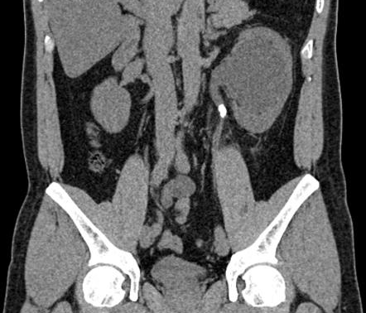
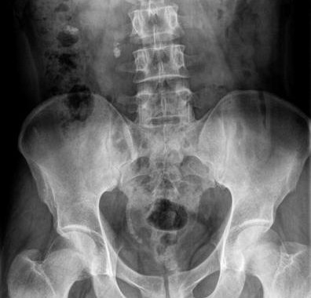
Method
The correlation of biochemical changes with the imaging results obtained during and after stone dropping of patients whose acute renal colic symptoms disappeared during follow-up were valuated, and the place of computed tomography in follow-up was evaluated.
The discharge of patients with improved symptoms and laboratory values without computed tomography and other imaging methods were retrospectively investigated.
The study was conducted with 62 people.

Slide 5
Inclusion criteria:
Being in the ICD10-N20 diagnostic code with kidney and ureter stone group
Imaging was performed at the first application and follow-up of the patient.
An age range of 18-80
To have the biochemical parameters examined at the first application and follow-up of the patient.
The patient has been evaluated by the urology outpatient department,
Exclusion criteria:
Patients who have had kidney stone surgery before
Patients <18 and> 80 years old
Patients with Chronic Renal Failure
Being pregnant

Slide 6
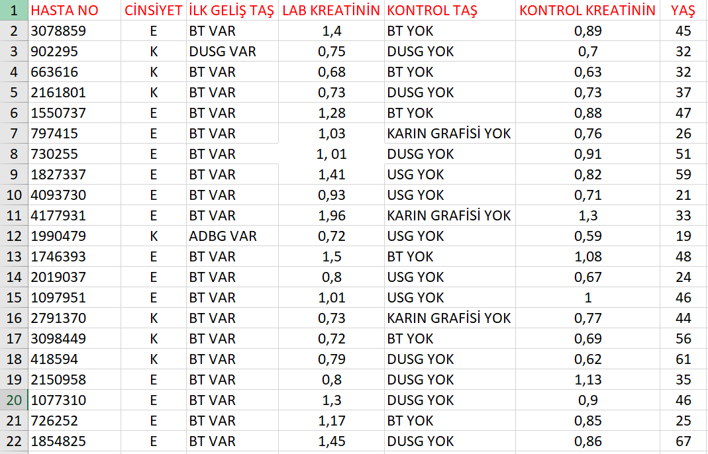

Slide 7
Results
61% of the patients in the study were men and 39% were women.
The average age of the patients is 44.62 years.
Considering the mean differences between first time creatinine and control creatinine measurements, a statistically significant difference was found between them (p<0,001).
The median value of first arrival creatinine (0,80-1,25) is 0.20 units higher than the median value of control creatinine (0,71-0,93).
 |  | CREATININE | CONTROL CREATININE
N | Valid | 62 | 62
Mean |  | 1,0682 | 0,8144
Std. Deviation |  | 0,36392 | 0,15303
Minimum |  | 0,60 | 0,50
Maximum |  | 2,52 | 1,30
Percentiles | 25(Q1) | 0,8000 | 0,7100
 | 50(Medyan) | 1,0100 | 0,7950
 | 75(Q3) | 1,2525 | 0,9325

Slide 8
Conclusion
The results of the present study show that follow-up of renal colic patients with biochemical parameters is as significant as follow-up with imaging methods.
It is possible for patients to be discharged by looking at their creatinine values.

Slide 9
References
Alabousi, A., Patlas, M. N., Mellnick, V., Chernyak, V., Farshait, N., &amp; Katz, D. S. (2019). Renal Colic Imaging: Myths, Recent Trends, and Controversies. Canadian Association of Radiologists Journal, 70(2), 164-171.
Gershan, V., Homayounieh, F., Singh, R., Avramova-Cholakova, S., Faj, D., Georgiev, E., ... &amp; Kharuzhyk, S. (2020). CT protocols and radiation doses for hematuria and urinary stones: Comparing practices in 20 countries. European Journal of Radiology, 108923.
Hall, T. C., Stephenson, J. A., Rangaraj, A., Mulcahy, K., &amp; Rajesh, A. (2015). Imaging protocol for suspected ureteric calculi in patients presenting to the emergency department. Clinical radiology, 70(3), 243-247.

Slide 10
THANKS FOR LISTENING…

